Slide 1


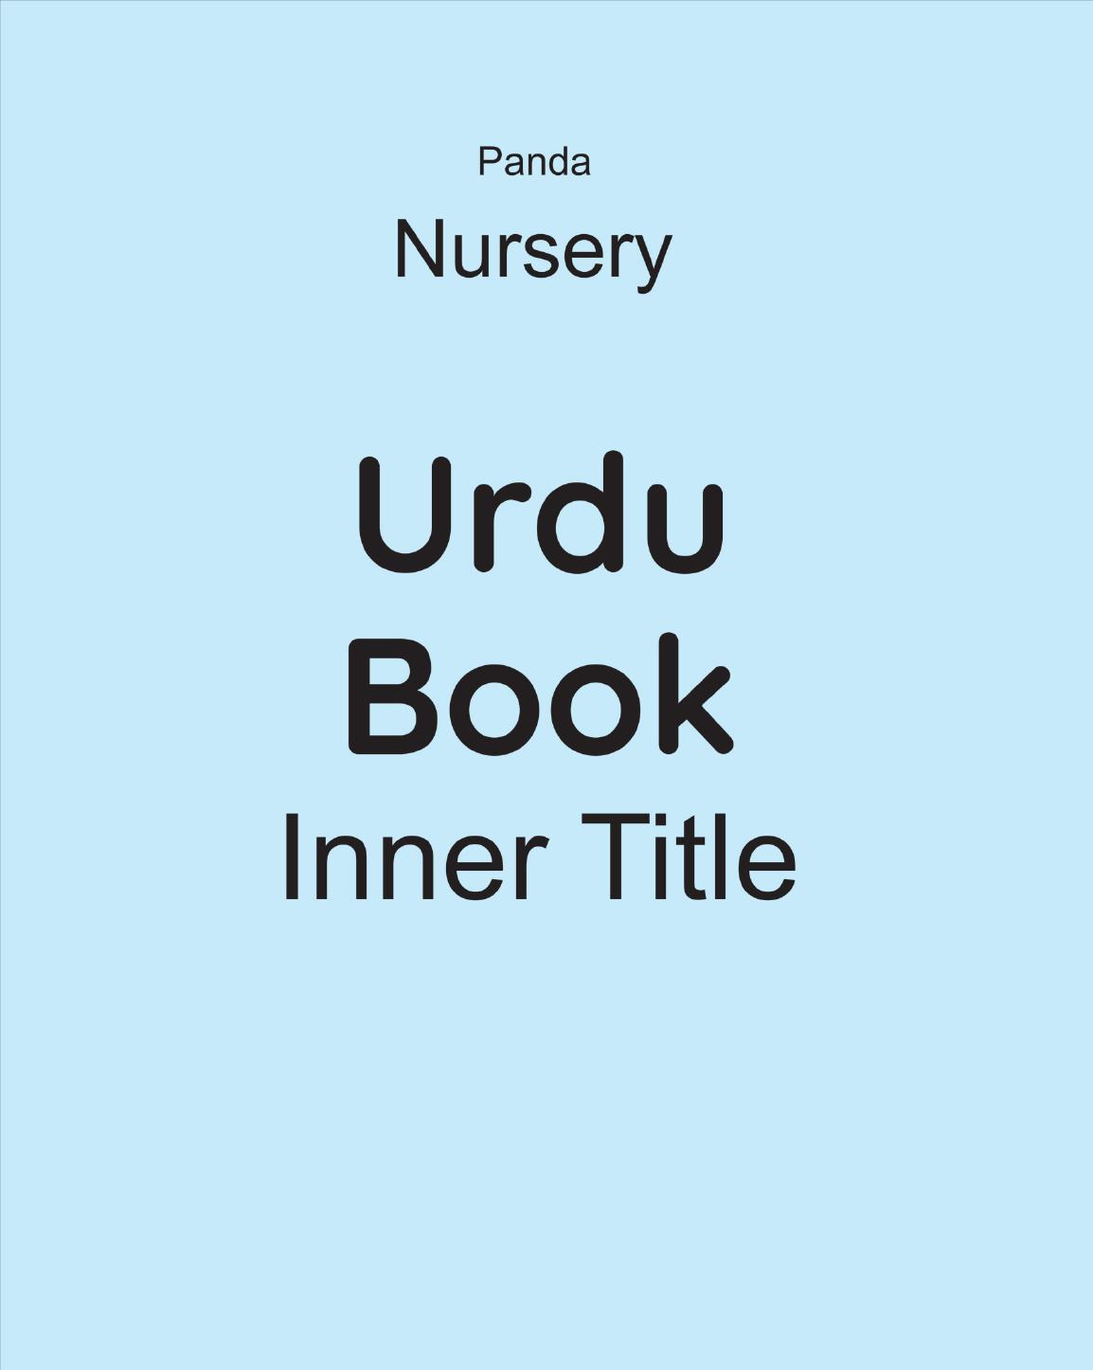
Panda Urdu Qaida
Nursery • Age 4+
An activity-based early-years book from the Panda Series.
A Project of Azhar Publishers & Book Factory

Slide 2
i
What's Inside
Panda Urdu Qaida Nursery • Age 4+
1
The full Urdu alphabet with key words
2
Letter shapes and guided tracing
3
Joined (bhari) letters — بھاری حروف
4
Two- and three-letter words
5
Aerab (zabar, zer, pesh)
6
Colourful picture activities and revision

Slide 3
★
Purpose & Classroom Support
Familiarises Nursery learners with the complete Urdu alphabet, letter joining, first words and aerab through big pictures and structured practice.
“
Every book comes with
1
2
3
Teacher's Lesson Plan
Practice Papers
Digital Interactive Version
A 40-week lesson plan that guides teachers, day by day.
Monthly tests and term exam papers for children to attempt.
An interactive flipbook and digital exercises for engaging, screen-based practice.
A Project of Azhar Publishers & Book Factory

